Slide 1
Functional Programming with F#
Daniele Pozzobon

Slide 2
Today we are going to…
Have an introduction to the F# programming language
Configure the enviroment to develop with it
Have a look at some of the basics of the language
Get a feel of the advantages of a stronger type system
Pattern Match everything
Do some basic operations on collections
And finally we build a Text Adventure Game

Slide 3
What is Functional Programming?

Slide 4
What it’s not
Ever worked with ___ ?
Assembly
C
C++
Java/C#
Abstraction of the bare metal
a pointer is an address of the memory
OO paradigm uses objects that have state and some methods to modify it
Notes:
ever used C or C++, or even Assembly?
- Assembly is an abstraction of the bare metal
- you change directly the state of the memory cells
- your whole program focuses on doing calculations changing state of some memory
- C, C++ and all its derivates are only abstractio of this
- a pointer is an address of the memory
- OO paradigm uses object that have state and some methods to modify it

Slide 5
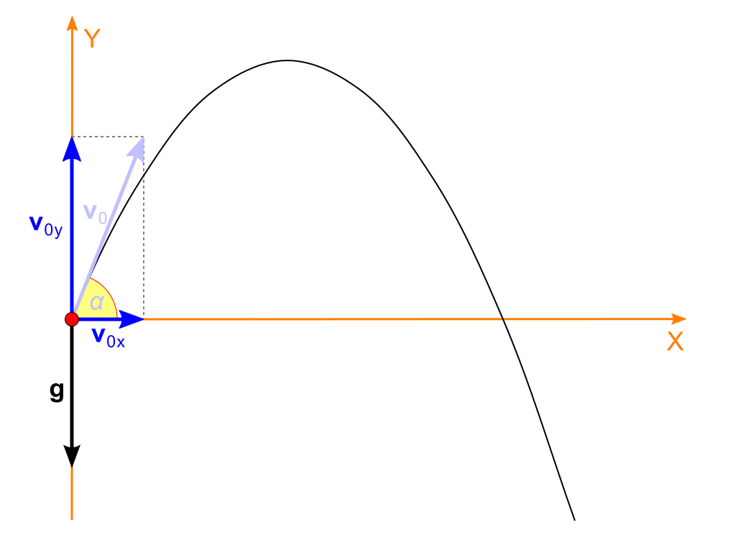
The world of Mathematics
Remember the definition of a function?
A relation between a set of inputs and a set of permissible outputs with the property that each input is related to exactly one output
Notes:
asigning a value to x means that x represents that value in the word of possible values, you cant change the value of x,
- for example the number two is a mathematical concept that can't change if you apply the number two to a funciton you obtain a result and that will always be the result of that function for that number

Slide 6

Let's do some physics
Uniform motion function:
$$x=v∗t$$
Can be rearranged to find t as a function of space (x), we say $t=f(x)$
$$t=\frac{x}{v}$$
The projectile function
$$\left\{\begin{aligned}{\text{x}\text{=}\text{v}}_{\text{x}}\text{×}\text{t} \\ {\text{y}\text{=}\text{v}}_{\text{y}}\text{×}\text{t}\text{+}\frac{\text{g} \text{×} {\text{t}}^{\text{2}}}{\text{2}}\end{aligned}\right.$$

Slide 7

Let's do some physics
We can express the height of the projectile based on its $x$
$$\left\{\begin{aligned}t=x/v_{x} \\ y=v_{y}×t+\frac{g × t^{2}}{2}\end{aligned}\right.$$
$$\left\{\begin{aligned}t:g(x) \\ y:f\left(t\right)→f\left(g\left(x\right)\right)→f°g(x)\end{aligned}\right.$$
$$y= \frac{v_{y}×x}{v_{x}}+\frac{g}{2} × {\left(\frac{x}{v_{x}}\right)}^{2}$$

Slide 8
Why all this?
Understanding concepts that are coming to come
Forget Memory cells → Function applications
Wanted to sound smart
Notes:
put you in the right mindset for what is coming
now when we talk about functions you know what I mean
it will be easier to not think about memory cells and instead thing about function applications

Slide 9
So what is functional programming
It's a programming paradigm that, as mathematics, uses function evaluation in order to express the relationship between the possible inputs (domain) and the possible outputs of a system.
Notes:
put you in the right mindset for what is coming
now when we talk about functions you know what I mean
it will be easier to not think about memory cells and instead thing about function applications

Slide 10
Key elements
Immutability by default
You have values not variables
Function application as main way to do calculations
Expressions instead of statements
Every function has One input and One output
Referential transparency
Functions are values too
Notes:
put you in the right mindset for what is coming
now when we talk about functions you know what I mean
it will be easier to not think about memory cells and instead thing about function applications

Slide 11
What is F#?
Functional First Programming Language
Multiparadigm
Impure
Developed by Microsoft Research
Inspired by ML

Slide 12
Characteristics of F#?
As general purpose as C#
Statically Typed
Concise Syntax
Immutability by defaut
Significance of White Space
Cross Platform

Slide 13
F# |> Statically Typed
F# has a better type system than C#
Can express business concepts with types
You can easily define a binary tree as
type Tree<'a> =
| Leaf
| Node of ('a * Tree<'a> * Tree<'a>)
Powerfull Type Inference

Slide 14
F# |> Immutablity
OO: No constraints over what mutates when
unpredictable because state can change at almost any time
What about when side effects affect shared resources?
Example: global state is considered harmful.
Parallel programming difficult
Notes:
using System; using System.Linq; class Example { public static int multiplier = 1; private static void ① Multiply(int value) { var result = value * multiplier; Console.WriteLine("{0} x {1} = {2}", value, ②multiplier++, result); } static void Main() { var range = Enumerable.Range(1, 100); foreach(var i in range) {
Multiply(i); } } }
static void Main() { var range = Enumerable.Range(1, 100); System.Threading.Tasks.Parallel.ForEach(range, i => Multiply(i)); }

Slide 15
F# |> Immutablity
In purely functional
programs composed by deterministic expressions
side effects are expressly forbidden
F# is an impure functional language.
you must explicitly allow for a value to be changed
restrict the value’s scope as much as possible
Advantages
more naturally suited for execution in parallel and concurrent environments
Reduce the need to lock shared resources
Ensures that multiple processes don’t make conflicting changes to the state
Easier to reason about
Notes:
using System; using System.Linq; class Example { public static int multiplier = 1; private static void ① Multiply(int value) { var result = value * multiplier; Console.WriteLine("{0} x {1} = {2}", value, ②multiplier++, result); } static void Main() { var range = Enumerable.Range(1, 100); foreach(var i in range) {
Multiply(i); } } }
static void Main() { var range = Enumerable.Range(1, 100); System.Threading.Tasks.Parallel.ForEach(range, i => Multiply(i)); }

Slide 16
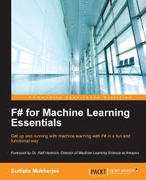
What can I do with F#?
Just Statistics and data analysis?
Yes but not limited to

Slide 17
What can I do with F#?
Parsers and Compilers
F# Compiler
Domain Specific Languages

Slide 18
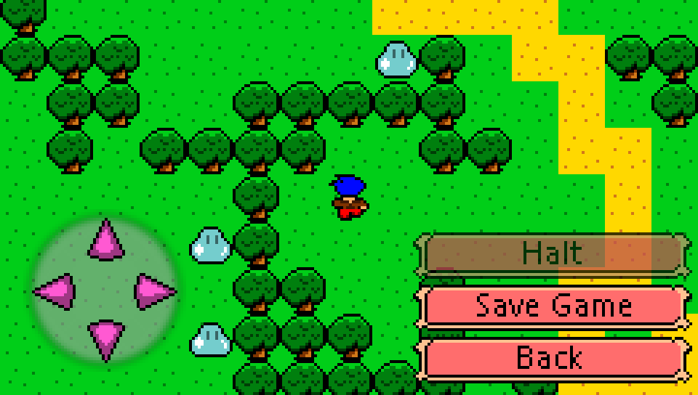
What can I do with F#?
Game Engines
https://github.com/bryanedds/Nu
https://medium.com/@bryanedds/functional-game-programming-can-work-95ed0df14f77

Slide 19
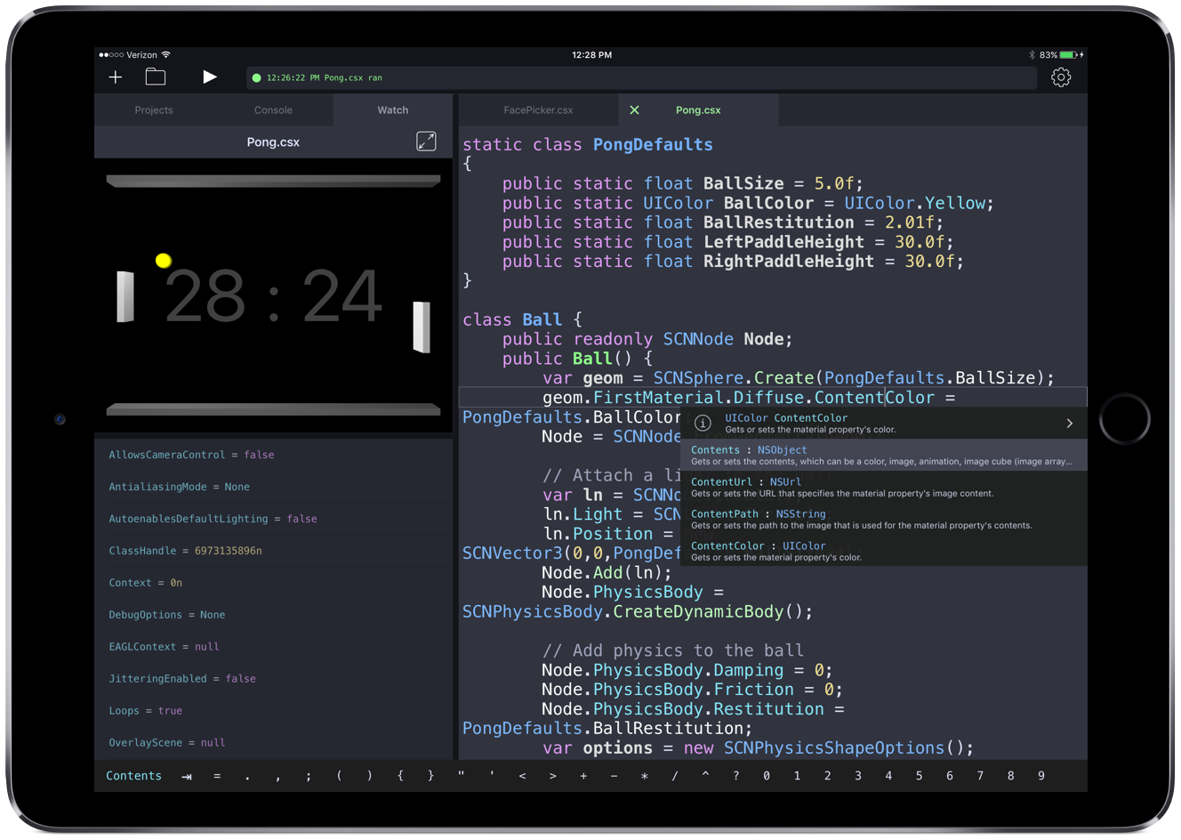
What can I do with F#?
Why not an IDE that runs on an IPad?
Continuous .NET C# and F# IDE

Slide 20
Configuring The Environment

Slide 21
Installing F#
Go to fsharp.org
Choose your platform
Windows
.Net 4.5
Install Fsharp Bundle
Build Tools
Don’t forget to add fsi to the path

Slide 22
Installing Visual Studio Code
Go to code.visualstudio.com
Download and install

Slide 23
Installing Ionide
Open Visual Studio Code and type the shortcut Ctrl+Shift+P this will open the command window
type in ext and press Enter
Search for Ionide and Install everything
Notes:
Ionde Progect is a set of plugings to help develop F# from any platform without the need for the whole Visual Studio. It's compattible with both Athom and VS Code (and maybe others...)

Slide 24
F# Basics

Slide 25
FSI
REPL
Two main usages
Running parts of software while developing
Running scripts to automate tasks
How to run
Typing fsi in console
Integrated in editor (Alt+ Enter inonide)
To run code in fsi type expression followed by ;;
1+1;;
Notes:
Read Evaluate Print Loop
Esercizi
Sommare due numeri
5+7
Moltiplicarli
5*7
Scrivere una stringa
«Hello World»
Concatenare una stringa
«Hello» + « World»

Slide 26
Exercise 1
Open the Command Line (cmd) and run fsi
Type
“Hello World!”;;
Type Enter
54.3;;
Type Enter
3 * 11;;
Type Enter
Try something

Slide 27
Exercise 2
Open Code
Type
“Hello World!”
Type Alt + Enter
54.3
Type Alt + Enter
3 * 11
Type Alt + Enter
Try something

Slide 28
FSI |> it
Support Binding
Used when no other binding gets defined
> 1+1;;
val it : int = 2
> (+);;
val it : (int -> int -> int) = <fun:it@1>
Notes:
Read Evaluate Print Loop

Slide 29
FSI |> Directives
#help;;
#quit;;
#load;;
#load ".\framework.fs"
#r;;
#r "System.FSharp.Data.dll"
#I;;
#I @"C:\Temp
#time "on";;
Notes:
#help;;
to lookup the directives
#quit;;
will quit the current session, you loose all job and values saved
#load;;
used to import code form other source files. You can use it by appending the path to the files you want to load
#load ".\framework.fs"
#r;;
used to import assemblies. You can use it by appending the path to the files you want to load
#r "System.FSharp.Data.dll"
You can load assemblies by path or you can just call the assebly if the file is in one directory listed in the search directory
#I;;
To add a folder to the search path in order to avoid writing the full path for asseblies that are not already in the search path
#I @"C:\Temp
#time "on";;
to enable the diplay of timing information and something more when the program prints to console

Slide 30
Defining values
Value != Variable
let
let two = 2;;
let five = 3 + two;;
let myName = "Daniele Pozzobon";;
let mutable
let mutable variable = 5
variable <- 6
Notes:
Definite:
un valore semplice
un valore dato da un calcolo
un valore floating point
una data
provate a sovrascrivere uno
valore mutable
sovrascrivetelo

Slide 31
Exercise 3
Define a simple value
Define a value computed as the multiplication of 2 values
Try to change the value
Define a mutable value
Override with the same type
Override with a different type
Keywords:
let
let mutable

Slide 32
Defining Functions
Definition:
let functionName parameter1 parameter2 … = body
example
let add a b = a + b
let addOne a = add 1 a
Let applyTen f = f 10
fun a b -> a + b
What happens if I call add without a parameter
> add 1;;
val it : (int -> int) = <fun:Invoke@3253>
let addOne = add 1
Notes:
Definire
- funzione moltiplicazione di due valori
- di tre
- calcolare il fattoriale (let rec)

Slide 33
Curring and partial application
every function accepts exactly one input and returns exactly one output
let add a b = a + b
val add : a:int -> b:int -> int
let add a =
let innerfun b = a + b
innerfun
Partial application allows to create new functions from existing ones
The compiler evaluates the curried function as far as it can with the provided arguments and binds the resulting function to the name
let addTen = add 10
let addTen = add 10 = fun b -> (+) 10 b
let addTen b = (+) 10 b
Notes:
Definire la funzione moltiplicazione di 2 come funzione curried

Slide 34
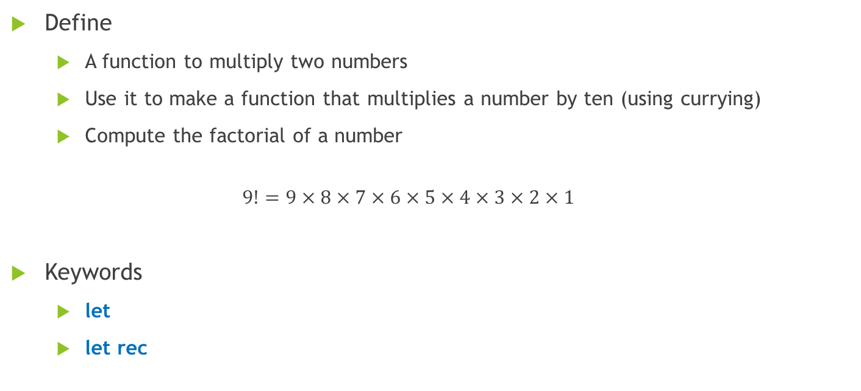
Exercise 4
Define
A function to multiply two numbers
Use it to make a function that multiplies a number by ten (using currying)
Compute the factorial of a number
$$9!=9×8×7×6×5×4×3×2×1$$
Keywords
let
let rec

Slide 35
Higher order functions
Functions are treated as values
A higher-order function is a function that takes another function as a parameter, or a function that returns another function as a value, or a function which does both.
Eg: The derivative function takes a function f(x) as a parameter, and it returns a completely different function f'(x) as a result.
deriv(f(x)) = f’(x)
let square x = x * x
let cube x = x * x * x
let sign x =
if x > 0 then "positive"
else if x < 0 then "negative"
else "zero"
let passFive f = (f 5)
Notes:
Modificare funzione di ordinamento di un array
let mySort (arr:int array) =
let range = [0..(arr.Length - 2)]
let mutable sorted = false
while not sorted do
sorted <- true
for i in range do
if arr.[i] > arr.[i+1] then
let tmp = arr.[i]
arr.[i] <- arr.[i+1]
arr.[i+1] <- tmp
sorted <- false
arr

Slide 36
Function Composition
allows you to create function chains
It comes in two forms: forward (>>) and backward (<<)
Generate new functions.
let averageInCelsius = List.average >> fahrenheitToCelsius;;
val averageInCelsius : (float list -> float)

Slide 37
Type Inference
The compiler can understands the data type based on some values and it’s usages
Feels like a DynamicallyTyped Language
It actually is Statically Typed
In C# you still have to declare
fields,
properties,
parameters
even method return
Notes:
type Person = { Name: string; Surname : string}
let io = {Name = "Daniele"}

Slide 38
Type Inference
using System;
public class Person
{
public Person(Guid id, string name, int age)
{
Id = id;
Name = name;
Age = age;
}
public Guid Id { get; private set; }
public string Name { get; private set; }
public int Age { get; private set; }
}

Slide 39
Type Inference
type Person (id : System.Guid, name : string, age : int) =
member x.Id = id
member x.Name = name
member x.Age = age

Slide 40
Working With Types

Slide 41
Core Types
Standard .Net types
Booleans
Numerics
Strings
…

Slide 42
Tuples
Defined as a comma separated collection of values
(1, “hello World”) → int * string
Group together related values
Can be used to return multiple values
let divide x y =
match y with
| 0 -> None
| _ -> Some (x / y, x % y)
Notes:
Scrivere una funzione dato due numeri torni le Quattro operazioni sui numeri in ordine
somma, differenza, moltiplicazione, divisione

Slide 43
Record Types
allow you to group values in a single immutable construct
Like tuples with labeled positions
Record type definitions consist of the type keyword, an identifier, and a list of labels with type annotations all enclosed in braces
type rgbColor = { R : byte; G : byte; B : byte }
let red = { R = 255uy; G = 0uy; B = 0uy }
let yellow = { red with G = 255uy }
Notes:
Definire un record per l’indirizzo,
Via
Ncivico
Cap
Provincia
Stato

Slide 44
Discriminated Unions
are user-defined data types whose values are restricted to a known set of values called union cases.
Similar to enumeration but:
the only valid values for discriminated unions are their union cases
each union case can either stand on its own or contain associated immutable data
Definition
type Name =
| UnionCase1 of sometype
| UnionCase2 of sometype
| UnionCase3 of sometype
///
type Shape =
| Circle of float
| Rectangle of float * float
| Triangle of float * float * float
Notes:
https://fsharpforfunandprofit.com/posts/discriminated-unions/
They define a sum type

Slide 45
Option Type
built-in Option<'T> type is a Discriminated Union:
type Option<'T> =
| None
| Some of 'T
defines two cases, None and Some.
None: an empty union case, meaning that it doesn’t contain any associated data.
Some: has an associated instance of 'T as indicated by the of keyword.
Notes:
Lista di id di student e voglio avere tutti I loro voti per fare una media
Ogni student potrebbe o no avere voti
Ma se un id non si trova nella tabela cosa torno?

Slide 46
Exercise 5
Define a function that given two ints returns the result of the 4 operations as a tuple
let calculate a b =
Define a record type for the result of the above function
type OperationResult =
Define the Number type that can be a float an integer or nothing
type Number =

Slide 47
Pattern Matching
Prepare yourself to get amazed!

Slide 48
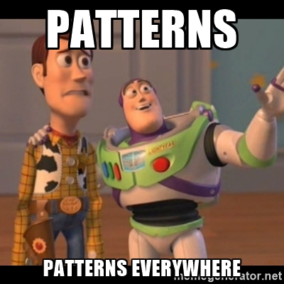
Pattern Matching
One of F#’s Most Powerful features
Found Litterally every where in the language
let f,s = …
fun a b c -> …
Match x with …

Slide 49
Matching Expressions
Switch statement on steroids
Switch operate against constant values
Selects the branch based on which pattern matches the input
match test-expression with
| pattern1 -> result-expression1
| pattern2 -> result-expression2
| ...
Notes:
you must organize your match expressions such that the patterns are listed from most to least specific
can be used with a wide variety of data types including (but not limited to) numbers, strings, tuples, and records.
let isEven n =
if n % 2 = 0 then true
else false

Slide 50
Like a switch statement
You can match an input of any type:
let numberToString input =
match input with
| 0 -> "zero"
| 1 -> "one"
| 2 -> "two"
| 3 -> "three"
Here there’s a possible problem

Slide 51
The Wildcard Pattern
The Wildcard pattern (_) discards the matched value
let numberToString input =
match input with
| 0 -> "zero"
| 1 -> "one"
| 2 -> "two"
| 3 -> "three"
| _ -> "unknown"

Slide 52
Variable Patterns
When you match a value and bind that value to a name:
let numberToString input =
match input with
| 0 -> "zero"
| 1 -> "one"
| 2 -> "two"
| 3 -> "three"
| n -> sprintf "%O" n

Slide 53
Guard Clauses
allow you to specify additional criteria that must be met to satisfy a case
let testNumber value =
match value with
| v when v < 0 -> printfn "%i is negative" v
| v when v > 0 -> printfn "%i is positive" v
| _ -> printfn "zero"
Notes:
Even though any integer will match any of the three patterns, the guard clauses on patterns ① and ② cause matching to fail unless the captured value meets their criteria.

Slide 54
Pattern-Matching Functions
the match...with portion of the match expression is replaced with function
let testOption =
function
| Some(v) -> printfn "Some: %i" v
| None -> printfn "None";;

Slide 55
Exhaustive Matching
When every test is checked
If a value exists that isn’t covered by a pattern, the compiler issues a warning
let numberToString =
function
| 0 -> "zero"
| 1 -> "one"
| 2 -> "two"
| 3 -> "three";;

Slide 56
Matching Discriminated Union
type Shape =
| Circle of float
| Rectangle of float * float
| Triangle of float * float * float
let getPerimeter shape =
match shape with
| Circle(r) -> 2.0 * System.Math.PI * r
| Rectangle(w, h) -> 2.0 * (w + h)
| Triangle(l1, l2, l3) -> l1 + l2 + l3

Slide 57
Exercise 6
Add Pentagon to the Shape discriminated union
Write the perimeter for that shape
Write a getAreaFunction for the Shapes
Area of the penthagon = (5s²) / (4√(5-2√5))

Slide 58
Matching Records
type Name = { First : string; Middle : string option; Last : string }
let formatName name =
match name with
| { First = f; Middle = Some(m); Last = l } -> sprintf "%s, %s %s" l f m
| { First = f; Middle = None; Last = l } -> sprintf "%s, %s" l f
let hasMiddleName name =
match name with
| { Middle = Some(_) } -> true
| { Middle = None } -> false

Slide 59
Working with Data

Slide 60
List
An ordered collection of related values
Roughly equivalent to a linked list
Definition:
[] → empty list
3 :: 23 :: 12 :: []
[1; 2; 3; 5; 28; 12]
[1..10]
[ for a in 1 .. 10 do yield (a * a) ]
List.init 5 (fun index -> index * 3)
Notes:
Provare a costruire le liste nei primi quattro casi
Construite una lista di nomi assegnandola ad un valore
Proviamo a vedere che proprietà ha

Slide 61
Set
unordered data structures
Do not preserve the order of elements as they are inserted
Not duplicates.
Definition:
Set.empty.Add(1).Add(2).Add(7)
Set.ofList ["Mercury"; "Venus"; "Earth"; "Mars"]

Slide 62
Sequence
Called also Sequence Expressions
Computed Lazilly
Can represent infinite data structure
Definition:
seq { expr }
seq { 1..100 }
seq { for a in 1 .. 10 do yield a, a*a, a*a*a }
Seq.initInfinite ((+)1)
Notes:
["Mercury"; "Mercury";"Venus"; "Earth"; "Mars"]
|> List.map (fun x ->
printf "%s\n" x
x.ToUpper())
|> List.take 2
seq { 1..100 }
|> Seq.map (fun x ->
printf "%d\n" x
x * 10)
|> Seq.take 2

Slide 63
Pipe Operator
Allows to create function chains
Evaluate one expression and send the result to another function
Forward Pipelining |>
To send values left to write
Compare
[1..10]
|> List.map addOne
|> List.map multiplyByTwo
|> List.sum
to
List.sum(List.map multiplyByTwo (List.map addOne ([1..10])))
Notes:
let fahrenheitToCelsius degreesF = (degreesF - 32.0) * (5.0 / 9.0)
let marchHighTemps = [ 33.0; 30.0; 33.0; 38.0; 36.0; 31.0; 35.0; 42.0; 53.0; 65.0; 59.0; 42.0; 31.0; 41.0; 49.0; 45.0; 37.0; 42.0; 40.0; 32.0; 33.0; 42.0; 48.0; 36.0; 34.0; 38.0; 41.0; 46.0; 54.0; 57.0; 59.0 ]
marchHighTemps |> List.average |> fahrenheitToCelsius |> printfn "March Average (C): %f"

Slide 64
Map
A way to apply a transformation function to a collection
List.map (fun x -> x * 2) [1..10]
[2; 4; 6; 8; 10; 12; 14; 16; 18; 20]
Oppure
[1..10]
|> List.map (fun x -> x * 2)
Oppure
let multiplyListBy2 = List.map (fun x -> x * 2)

Slide 65
Filter
A way to select some values of a collection based on an expression
List.filter (fun x -> x % 2 = 0) [1..10]
[2; 4; 6; 8; 10]

Slide 66
Exercise 7
Greetings
Given a list of names select all the names that start with the letter ‘A’ and prepend “Hello “ to it
Example [“Elena”; “Amelia”] → [“Hello Amelia”]
Keywords
List.map
List.filter
Bonus point
Use the printf function to print all the results
Make the choice of the first letter a parameter

Slide 67
Fold
Applies a function to each element
Aggregates the result of the function in an accumulator
Returns the accumulator as the result of the fold operation
let factorial n =
List.fold (*) 1 [1..n]
factorial 5

Slide 68
Cons Patterns
cons operator (::) works in reverse; instead of prepending an element to a list, it separates a list’s head from its tail
let getLength n =
let rec innerFn c l =
match l with
| [] -> c
| _ :: t -> innerFn (c + 1) t
innerFn 0 n

Slide 69
A Sharp Adventure

Slide 70
Final Exercise
Let's build a text adventure game
Rules
Everything has a name and a description
The World contains a set of Rooms and a Player
A Player can be in a Room
A Player has an Inventory of Items
A Room can have a Items in it
a Room have 4 Exists: North, South, East, West
a Room have an identifier called RoomId

Slide 71
Final Exercise
Rules
An Exit can be Locked or Passable
An Exit can be marked as NoExit to
A Locked Exit can be Opened with specific Key

Slide 72
Final Exercise
Rules
Every turn the player can do some action (eg. Move, Look, Pick, Act)
The player can Move from one Room to one of the 4 Directions
The player can change room only if the Exit is Passable otherwise it remains in the same Room
The player can Look in one of the four Directions
The player can unlock Locked exits
…

Slide 73
Final Exercise
Assignment
Build a function to move from one room to another
For bonus points
Build a function to Look at every direction
Build a function to unlock a locked door

Slide 74
Resources
http://fsharp.org/
http://fsharpforfunandprofit.com/
https://www.gitbook.com/book/swlaschin/fsharpforfunandprofit/
http://theburningmonk.com/
https://en.wikibooks.org/wiki/F_Sharp_Programming
The Book of F#

Slide 75
Resources
https://github.com/ChrisMarinos/FSharpKoans
https://projecteuler.net
https://codewars.com

Slide 76
Contacts
d.pozzobon@reply.it
@pozzobondaniele
www.codecleane.rs

